Slide 1

Cyberbullying Detection using Machine Learning and Deep Learning
A Comparative Analysis and Implementation
Presented By: M Aishwaryaa Shree, Neelesh Agrawal, Kumar Abhishek

Slide 2
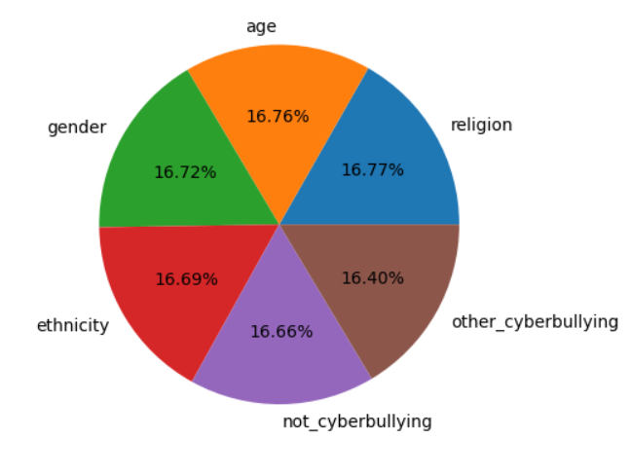
Introduction & Dataset
Cyberbullying is a digital-age social threat.
Our objective: Classify tweets as cyberbullying or not.
Dataset:
Kaggle - 47,000+ tweets
Labels: Age, Gender, Ethnicity, Religion, Other, Not Cyberbullying
Converted to binary classification (Cyberbullying / Not)

Slide 3

Preprocessing Pipeline
Code Example
Steps Taken:
def clean_tweet(tweet):
Why Preprocess?
Remove emojis, @mentions, hashtags, punctuation
Tweets are informal and noisy — needs cleaning.
tweet = emoji_pattern.sub('', tweet)
Lowercase & remove stopwords
tweet = re.sub(r'@\w+', '', tweet)
Filter non-English tweets
return ' '.join([...])
Convert to binary labels
Balance classes (downsampling)

Slide 4
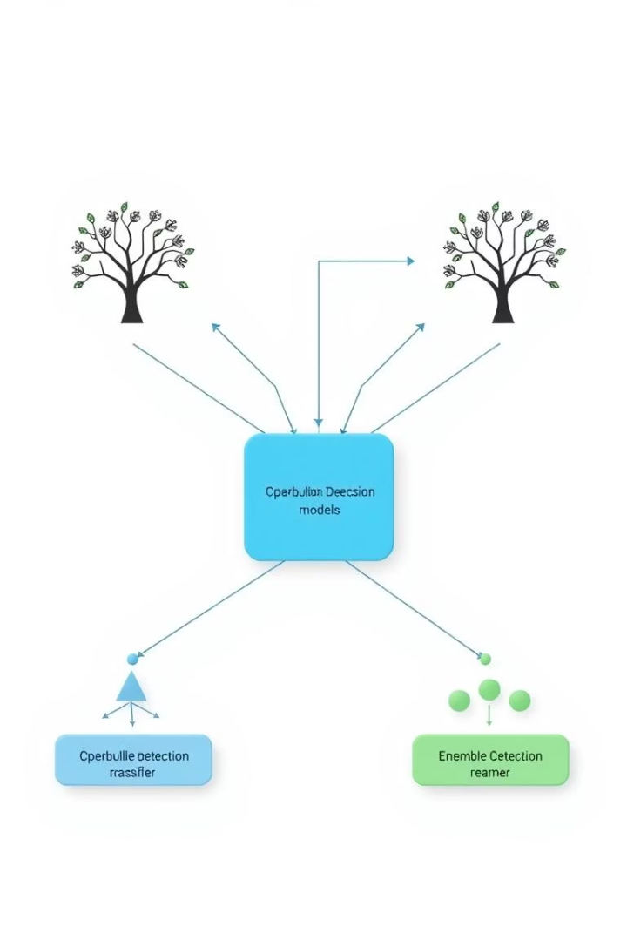
Machine Learning Models
Before Tuning:
After Tuning:
Logistic Regression
Tuned RF
Random Forest
GB
Gradient Boosting
XGB
SVC
Ensemble Models: Voting & Stacking
XGBoost
Why Ensemble?
Reduces bias & variance
Improves generalization

Slide 5
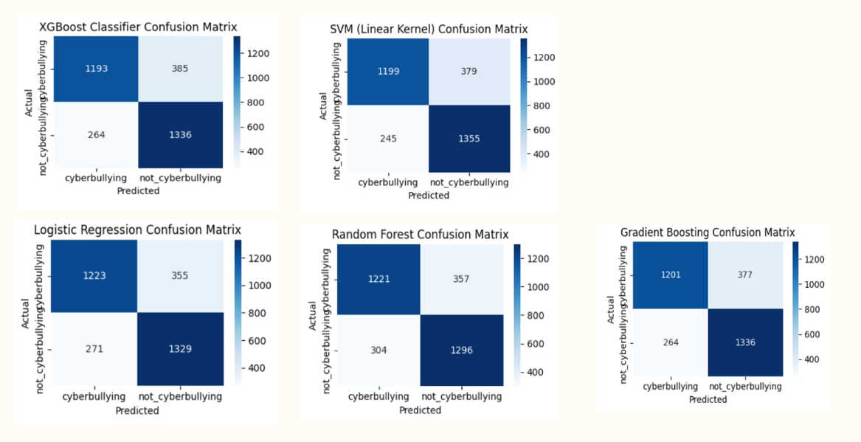
Before Tuning:

Slide 6
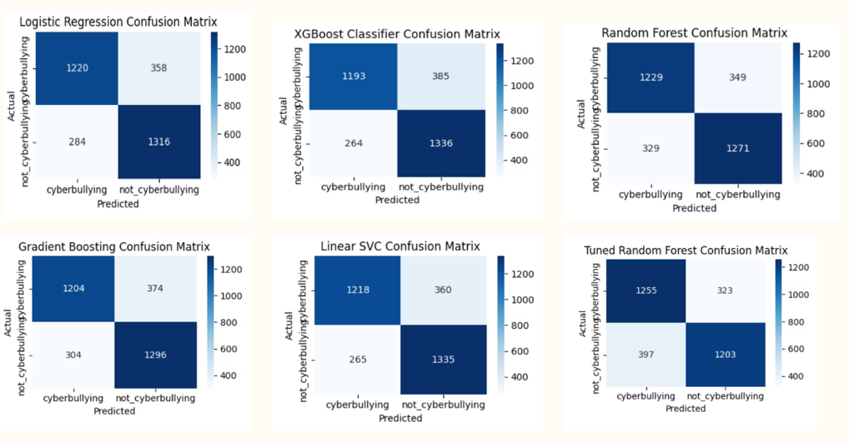
After Tuning:

Slide 7
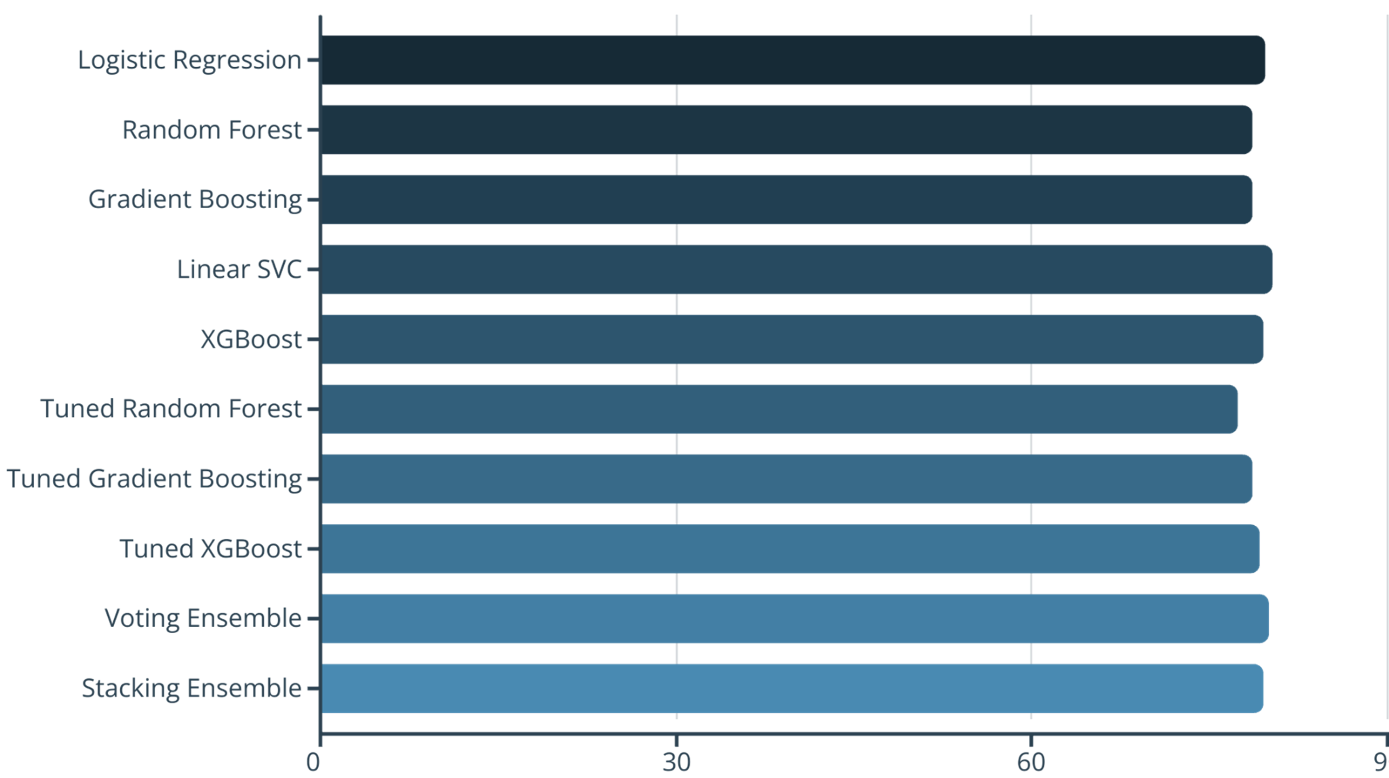
ML Evaluation

Slide 8
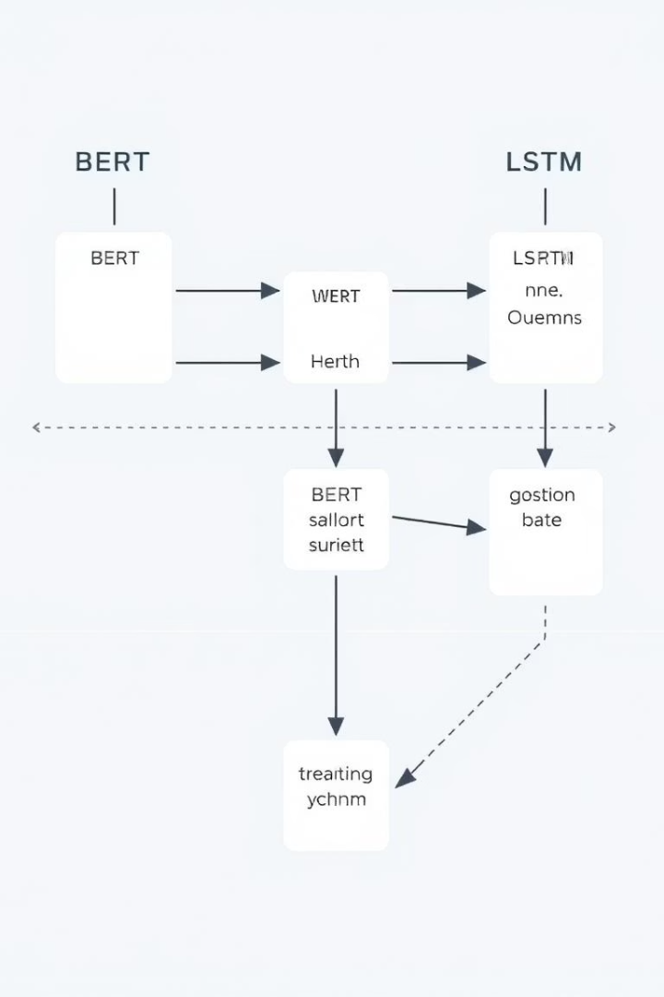




Deep Learning Models & Tools
BERT
RoBERTa
LSTM
Context-aware embeddings
Enhanced BERT
Captures sequential patterns
HAN
Attention over key words/phrases
Frameworks: PyTorch + Huggingface

Slide 9
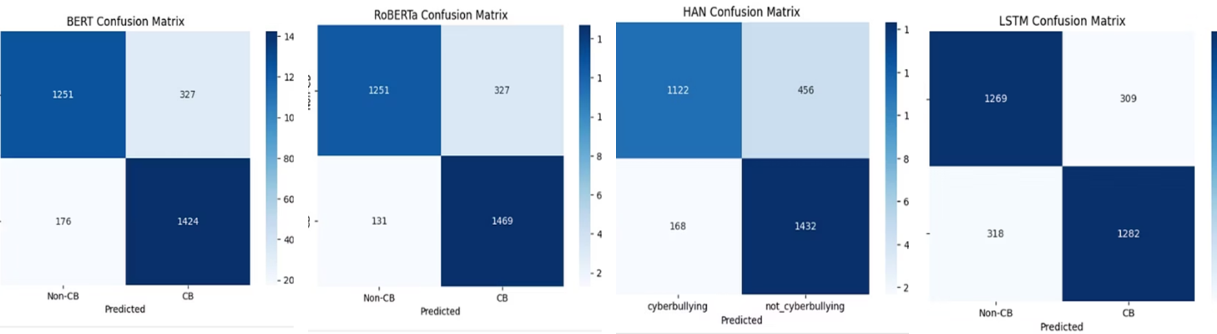

Slide 10



DL Pipeline & Code Sample
Tokenization
inputs = tokenizer(tweet, return_tensors="pt", truncation=True)
Model Forward Pass
outputs = model(**inputs)
Extract Embeddings
embedding = outputs.last_hidden_state[:, 0, :]
Used [CLS] token for classification
Fine-tuned on cleaned tweets

Slide 11
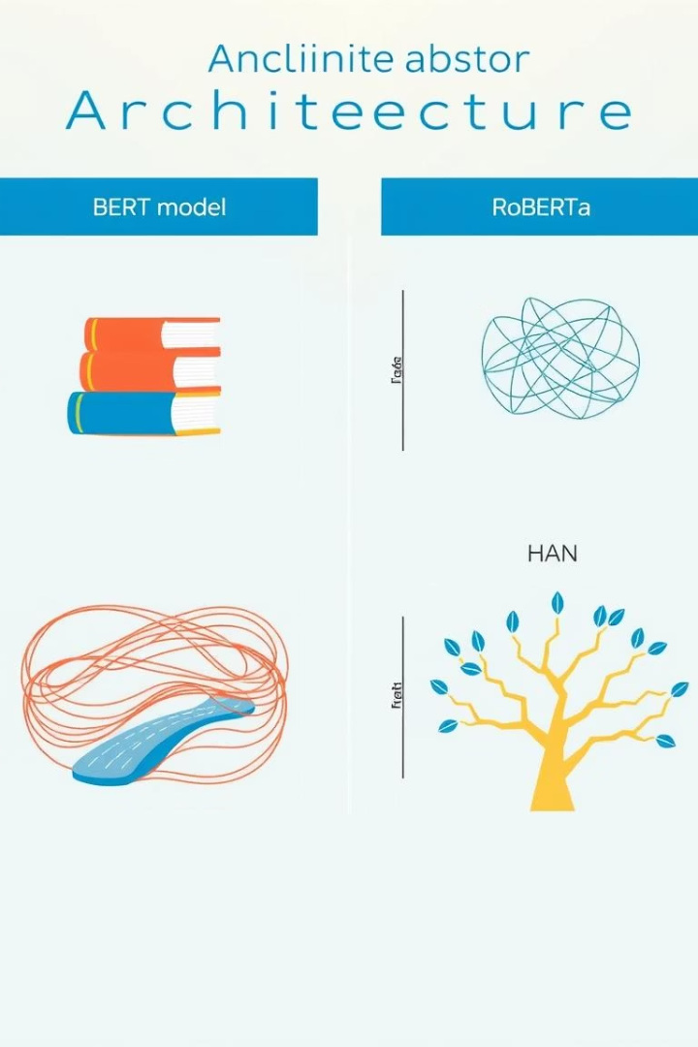
Why These DL Models?
Model
Strength
BERT
Handles indirect abuse/context
RoBERTa
Improved tokenization & semantics
LSTM
Detects sequential abuse/repetition
HAN
Weights important words for attention

Slide 12












Techniques to Prevent Cyberbullying
Data Cleaning & Label Simplification
Ensemble Learning
Combining multiple models
Preparing text for analysis
Performance Evaluation
Semantic Embeddings
Via multiple metrics
BERT, RoBERTa
Class Balancing
Sequence Models
Ensuring fair representation
LSTM, HAN

Slide 13






Conclusion
Future Work
Live deployment, multi-language support
Best Approach
Preprocessing + Embeddings + Ensemble = High accuracy
Key Findings
ML is efficient but context-limited
DL models provide deep understanding of language

